Slide 1


NEXT GEN EMPLOYABILITY PROGRAM
CREATING A FUTURE-READY WORKFORCE
Student Name :
MANAKAVOO SIVA BALAJI
Student ID :
STU6407ec1e09ed81678240798
Mobile No :
9566180741
Mail ID :
manakavoo.ug.21.ad@francisxavier.ac.in
College Name :
Francis Xavier Engineering College

Slide 2
CAPSTONE PROJECT SHOWCASE
Project Title
Health Care Data Driven Decisions using Power BI
Abstract | Problem Statement | Project Overview | Proposed Solution | Technology Used | Modelling & Results | Conclusion | Q&A

Slide 3
Abstract
1
This project focuses on leveraging Power BI for healthcare analytics to analyze patient data and derive actionable insights.
2
The analysis includes patient demographics, disease patterns, and treatment effectiveness, aiming to improve healthcare decision-making and patient outcomes.
3
By visualizing and analyzing the data, healthcare providers can gain valuable insights that can lead to more effective treatments and better patient care.

Slide 4


Problem Statement
Healthcare organizations face challenges in efficiently analyzing and utilizing vast amounts of patient data.
The lack of a comprehensive analytics solution leads to missed opportunities for improving patient care, treatment outcomes, and operational efficiency.
There is a pressing need for a robust analytics platform that can handle the complexities of healthcare data and provide actionable insights to healthcare providers.

Slide 5

Project Overview
Utilizing Power BI for healthcare analytics to analyze patient data.
Focus on understanding patient demographics, disease patterns, and treatment effectiveness.
Aim to improve healthcare decision-making and patient outcomes.
Project involves importing, cleaning, and visualizing patient data.
Creating insightful visualizations to derive meaningful conclusions from the data.

Slide 6
Proposed Solution
Use Power BI as the primary tool for data analysis and visualization.
Import and clean patient data to ensure accuracy and reliability.
Create interactive visualizations to explore patient demographics, disease patterns, and treatment outcomes.
Utilize Power BI's features for advanced analytics, such as forecasting and clustering, to gain deeper insights.
Enable healthcare providers to make informed decisions and improve patient care based on the analysis.

Slide 7
Technology used
Power BI: Power BI is the primary technology used for data visualization, exploration, and analysis. It provides robust features for creating interactive dashboards, reports, and visualizations from various data sources.
Data Integration Tools: Tools such as Microsoft SQL Server Integration Services (SSIS) or Azure Data Factory may be used for integrating data from disparate sources, including electronic health records (EHR), claims data, and other healthcare databases.
Data Cleaning and Preparation: Technologies like Microsoft Excel, SQL Server, or Python libraries such as Pandas may be utilized for data cleaning, transformation, and preparation before loading it into Power BI for analysis.
Database Technologies: Depending on the size and complexity of the data, database technologies like Microsoft SQL Server, Azure SQL Database, or other cloud-based databases may be employed for storing and managing healthcare data.
Advanced Analytics: For advanced analytics tasks such as predictive modeling or machine learning, programming languages like Python or R, along with libraries such as scikit-learn or TensorFlow, may be used in conjunction with Power BI.

Slide 8
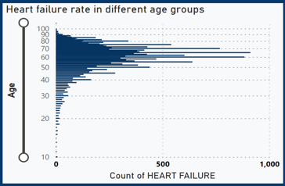
Modelling & Result

Slide 9
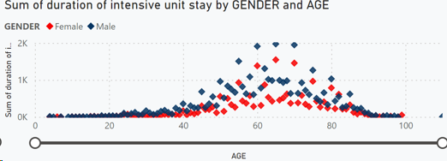
Modelling & Result

Slide 10
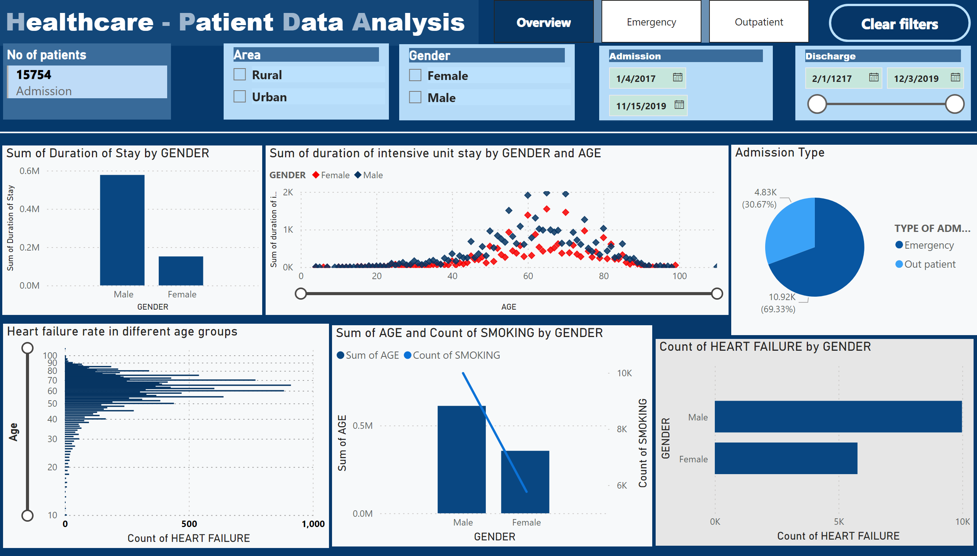
Modelling & Result

Slide 11

Conclusion
Power BI has been instrumental in analyzing patient data, providing valuable insights into demographics, diseases, and treatment outcomes.
The insights derived from this analysis can help healthcare providers make informed decisions and improve patient care.
Moving forward, these insights can be used to optimize treatment strategies and enhance overall healthcare services.
Power BI's capabilities in data visualization and analysis have proven to be highly effective in the healthcare analytics domain

Slide 12


Notes:
Thank You !!

